Slide 1
Harmony in the Nature and Existence
Unit 04

Slide 2

Harmony with the Nature
We get all basic needs as air, water, food and physical facilities from the nature.
Our existence is not possible without nature for a moment also.
So if all the things in the nature are balanced or enriched one then we will get happiness.

Slide 3
Understanding Harmony in Nature & Existence.
Whole Existence as Co-existence

Slide 4
Nature is the collection of units
Air Water Trees
Animals Human being Metals
Moon Sun Stars etc.
All are units in nature

Slide 5
All these units can be divided into four orders
Physical Order
Pranic Order
Animal Order
Human Order

Slide 6
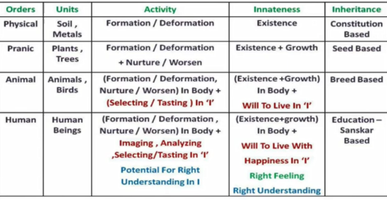
Four Orders

Slide 7
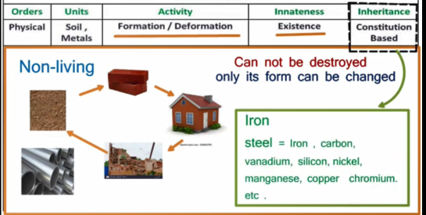
Physical Order

Slide 8
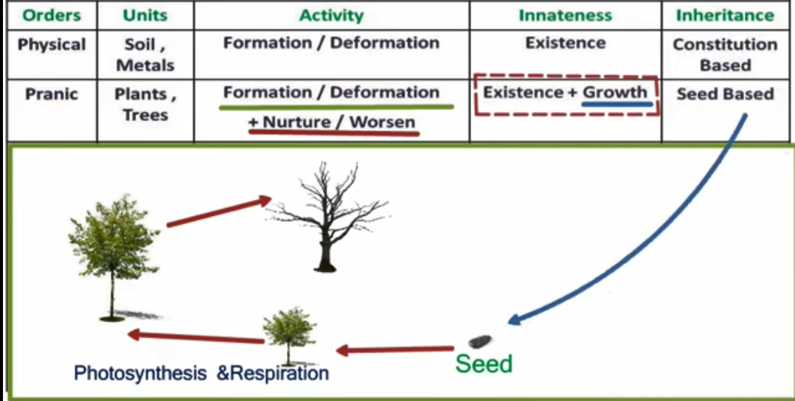
Pranic Order

Slide 9
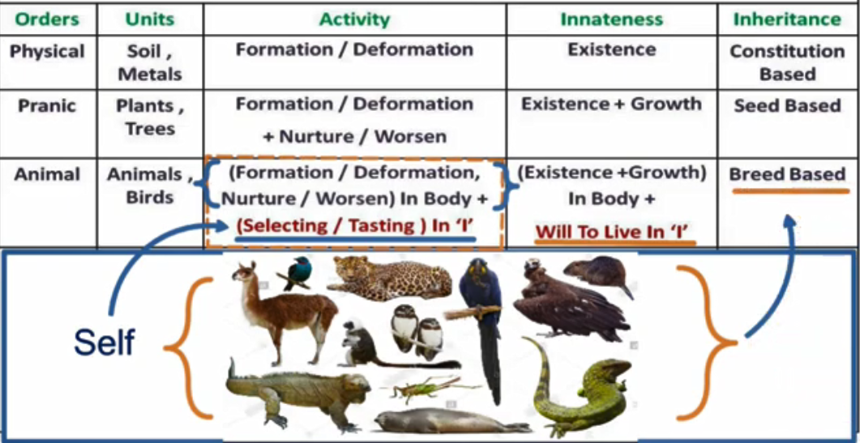
Animal Order

Slide 10
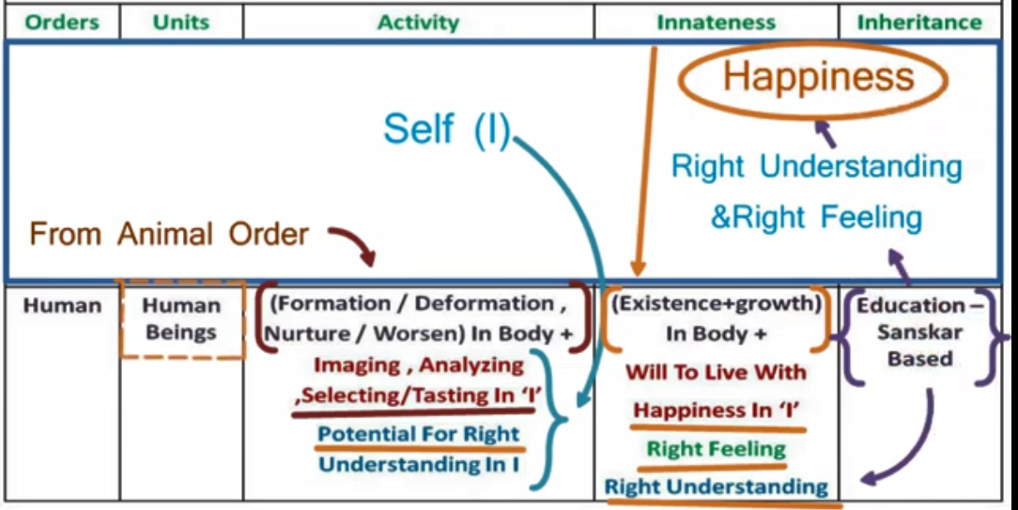
Human Order

Slide 11
Interconnectedness and
Mutual Fulfillment Among The Four Orders

Slide 12
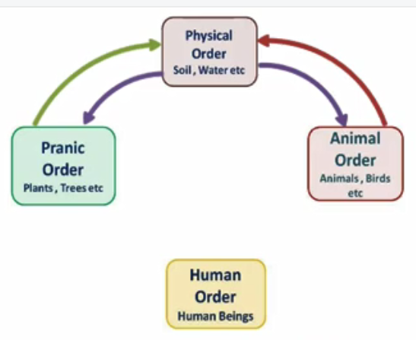
Physical Order
Physical order includes nonliving things as air, water, minerals and so on. It provides mineral and water to plants and animals. As the plants and animals die and decompose, the material returns back to soil and environment

Slide 13
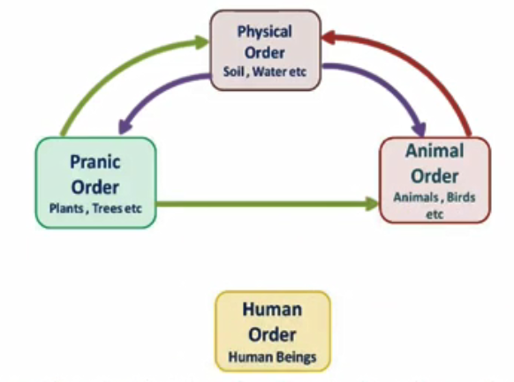
Pranic Order
Pranic Order includes all plants as herbs, shrubs, trees etc. Plants take up minerals and water from soil and carbon dioxide from air and convert solar energy into biochemical energy. Plants provide food for animals

Slide 14
Cont.
The material units of Physical Order and Pranic Order are transformable, and their composition keeps on charging, hence these are Gathansheel.

Slide 15
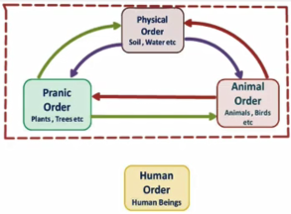
Animal Order
Animal order includes all animals as fishes, birds, mammals etc.
Animals take food from plants. After death they decompose and provide minerals and nutrients, to plants

Slide 16
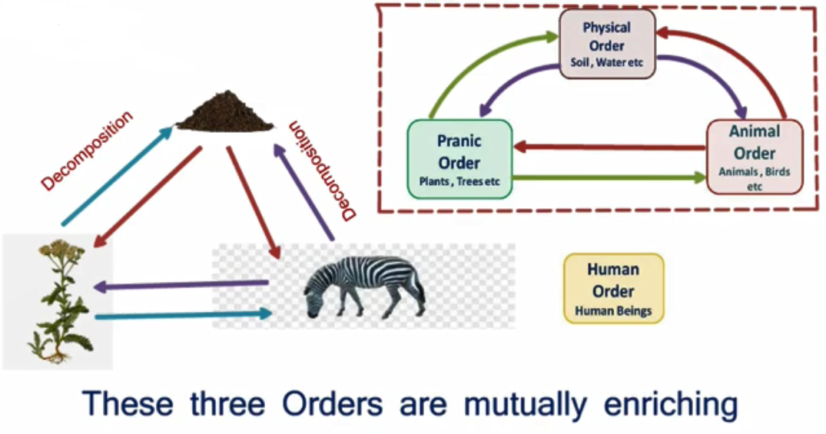

Slide 17
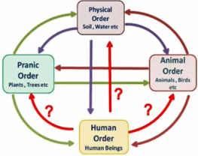
Human order includes Human Beings. Human beings fulfill their needs from Material Order.
Pranic Order and Animal Order but do not return back in right proportion so that ecological balance is disturbed.

Slide 18
The units of animal order and human order are the sentient (‘I’) units, which does not transform and are complete in composition, hence Gathanpurna

Slide 19
Human beings have Natural Acceptance to be mutually fulfilling.
Once human beings understand the mutual fulfillment they can be fulfilling of all

Slide 20
Participation of Human Being in Entire Nature
To Understand the inherent harmony in nature : There is already Harmony & balance in Nature. We do not have to create it.
To facilitate the innateness of all orders
To ensure the inheritance of all orders

Slide 21
Human participation for mutual fulfillment of all four orders.

Slide 22
Physical Order
Facilitate its existence by ensuring conducive environment and maintaining / ensuring its composition (e.g. constitution of Earth)

Slide 23
Pranic Order
Facilitate its growth by ensuring conducive environment and maintaining / ensuring its seed. Preserving Biodiversity.

Slide 24
Animal Order
Facilitate care of the body by ensuring physical facility, environment for existence and growth of body.
Facilitate its will to live by maintaining and showing its breed. Preserving Biodiversity.

Slide 25
Human Order
Facilitate care of the body by ensuring physical facility, environment for existence and growth of body.
Facilitate its will be live with continuous happiness by ensuring human Education – Sanskar.
Participating in developing, maintaining undivided Society and Universal Human Order.

Slide 26
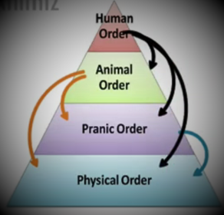
Dependence of any order is on all previous orders
Pranic Order is dependent on Physical Order
Animal Order is dependent on Pranic Order and Physical Order
Human Order depends on Animal Order, Pranic Order as well as Physical Order.

Slide 27
Nature is organized in such a manner that the physical facility required for any order is available in abundance.
Physical Order >>Pranic Order>>Animal Order>>Human Order

Slide 28
The first three orders are mutually fulfilling for each other. They are fulfilling for human being also.
It is naturally acceptable to human being to be fulfilling for all the orders.

Slide 29
But due to indefinite conduct (without knowing) he is living on assumptions which is the source of problem. The definite conduct of human being can be ensured by knowing and right understanding through Education and Sanskar

Slide 30
The role of human being is to realize this mutual fulfillment. For this all that human beings need to do is:
To understand that mutual fulfillment (harmony) is in inherent in nature – we do not have to create it.
To live accordingly – then the mutual fulfillment among the four orders will be realized.

Slide 31
Completion of right understanding in human being is called Kriyapurnata and ability to live with complete understanding is called Acharanpurnata.

Slide 32
Understanding Existence as Co-existence (Sah-astiva) of mutually interacting units in all-pervasive space

Slide 33
Existence : There are two kinds of realities in existence.
1. Units : Something that is limited in size e.g.: atoms, molecule, plant, animals, human beings etc.
2. Space: We can’t ‘touch it’ as a unit but it exists everywhere. We can just ‘see through it’

Slide 34
The units exit in space and between every two units there is a space.
We can say that:
Existence = Units in Space or
Nature in Space

Slide 35
So existence is actually co-existence

